Slide 1
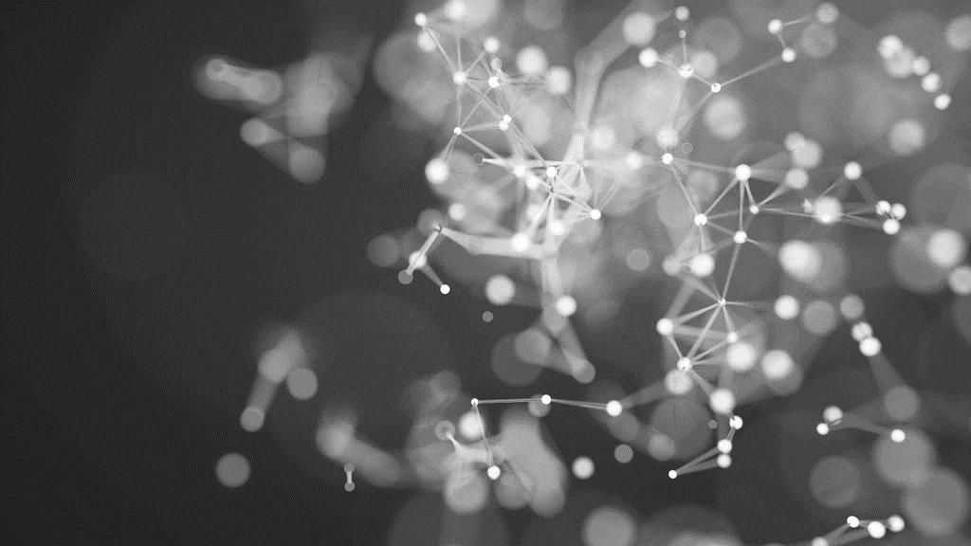

Feasibility Study on Automated Fish Species Classification Using Hybrid Deep Learning Models
Amirhosein mohammadisabet
Supervisor:
Dr Reza Hasan
09.09.2024

Slide 2

Agenda
INTRODUCTION
Literature Review
Methodology
Experimental Results and Analysis
Conclusion and Future Work
Questions and Discussion

Slide 3
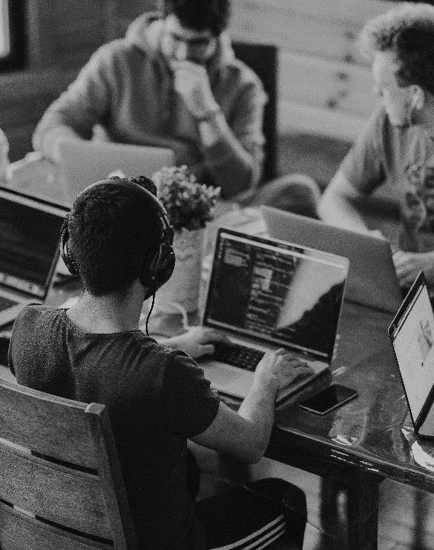
INTRODUCTION
Objective: Explore deep learning models for fish species classification from images.
Importance: Enhances ecological conservation, fisheries management, and biodiversity research.
Approach: Compare deep learning models with traditional machine learning methods.

Slide 4

Literature Review
Climent-Perez et al. (2024): Developed a workflow for fish segmentation and size estimation.
Kaur and Vijay (2024): A High Accuracy in octopus and crab species identification using CNN with SURF descriptor.
Dharshana et al. (2023): Improved underwater fish classification using YOLO for real-time detection.
Malik et al. (2023): Enhanced YOLOv7 outperformed other models in fish detection.
Smith et al. (2022): Leveraged transfer learning to boost fish species classification accuracy with reduced training time.
In summary CNNs, YOLO, and transfer learning are driving significant improvements in fish species identification accuracy.

Slide 5
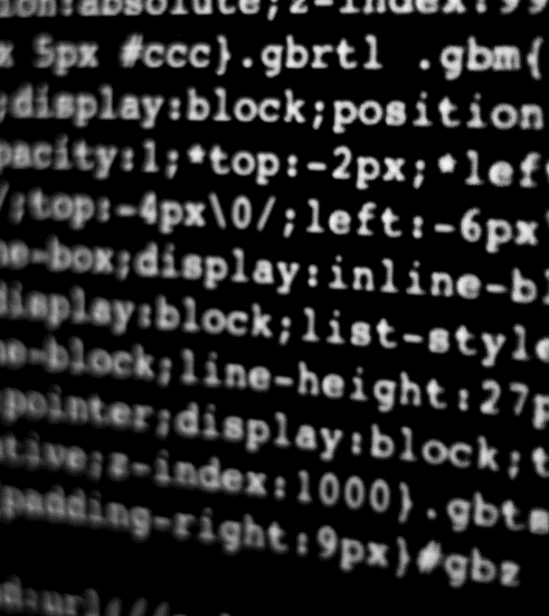
Experimental Results and Analysis

Slide 6
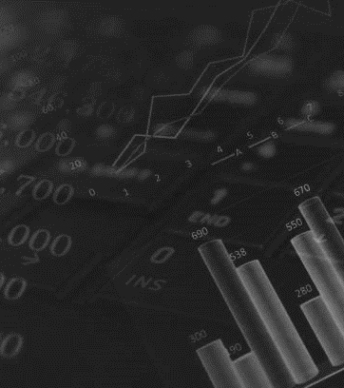
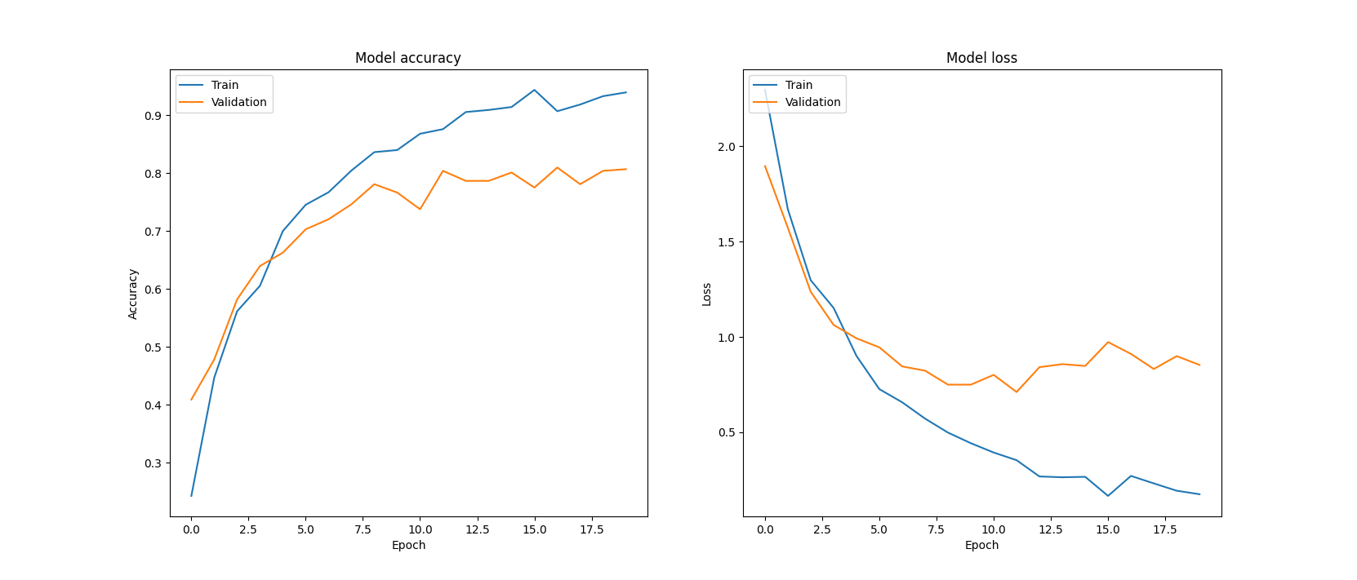
Deep Learning Models and Performance
Architecture: Three convolutional layers, max pooling, dense layer, dropout.
Accuracy: 80.00%
Plot: Training & Validation Accuracy and Loss

Slide 7
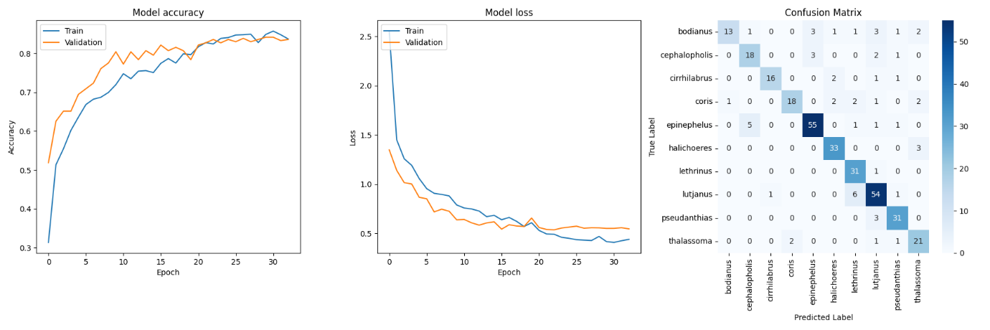
MobileNetV2
Architecture: Lightweight, depthwise separable convolutions.
Accuracy: 83.57%
Plot: Confusion Matrix, Training & Validation Accuracy and Loss

Slide 8
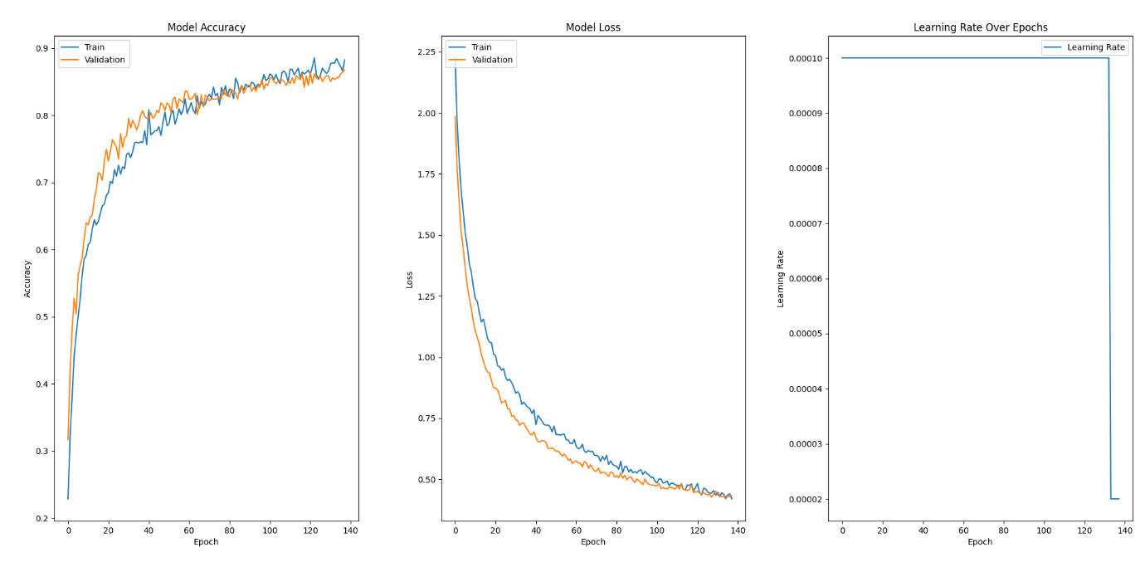
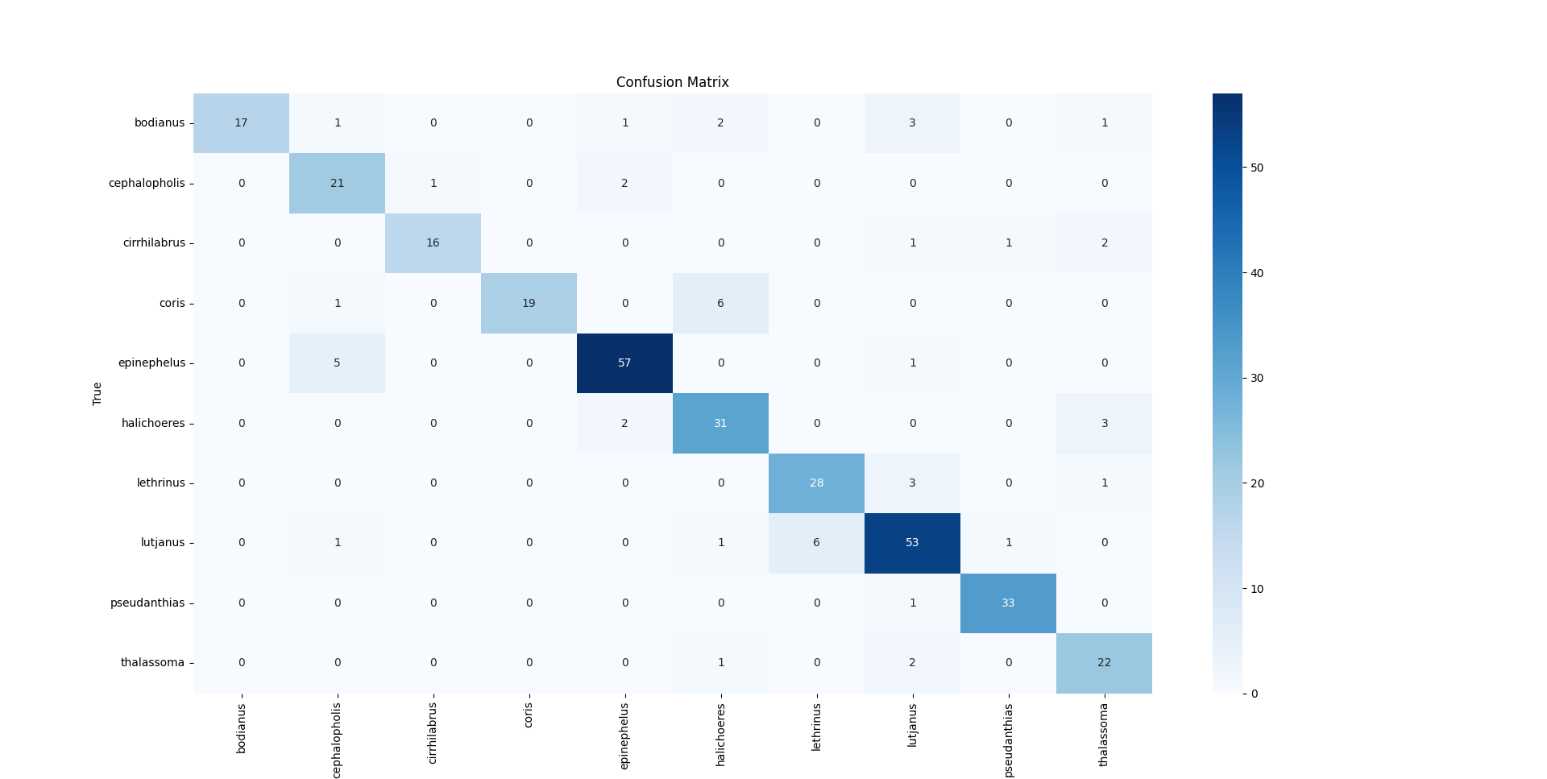
VGG16
Architecture: Deep, transfer learning with frozen convolutional base.
Accuracy: 87.61%
Plots: Training & Validation Accuracy and Loss, Confusion Matrix

Slide 9
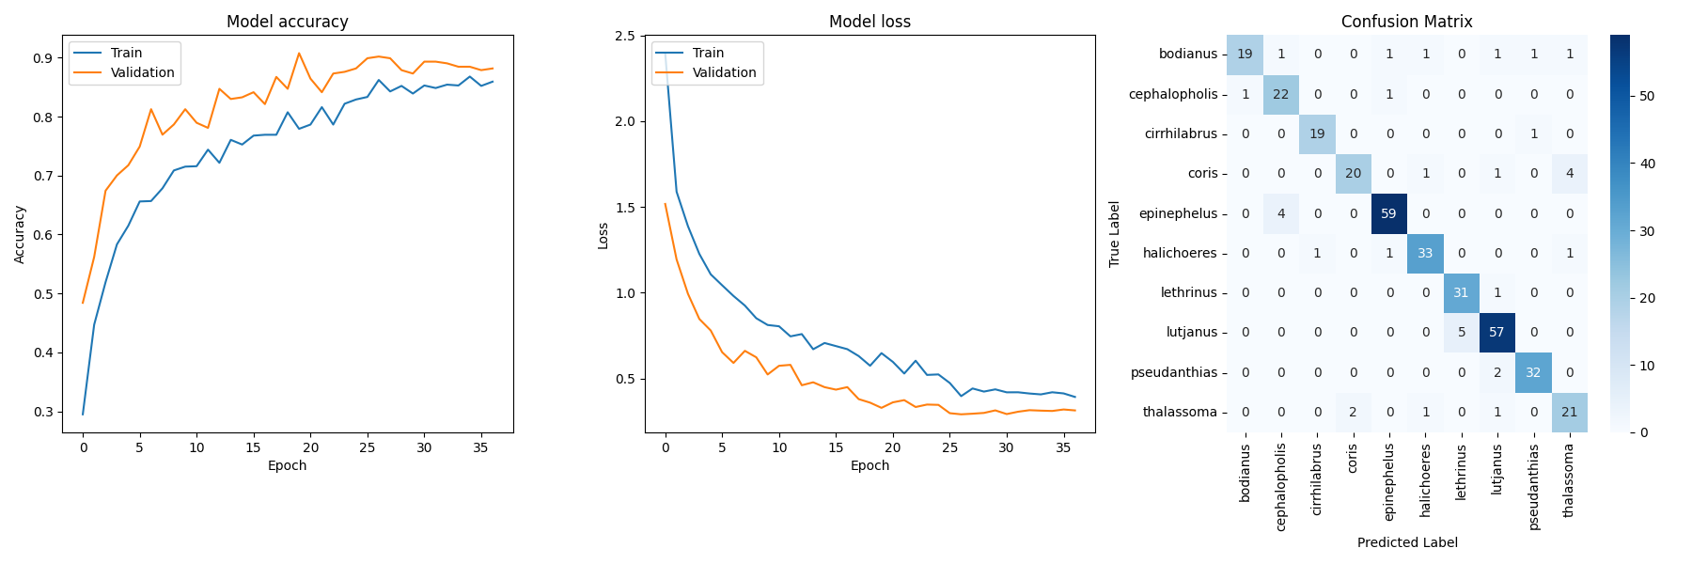
DenseNet121
Architecture: Dense connectivity for feature reuse.
Accuracy: 90.20%
Plots: Confusion Matrix, Training & Validation Accuracy and Loss

Slide 10
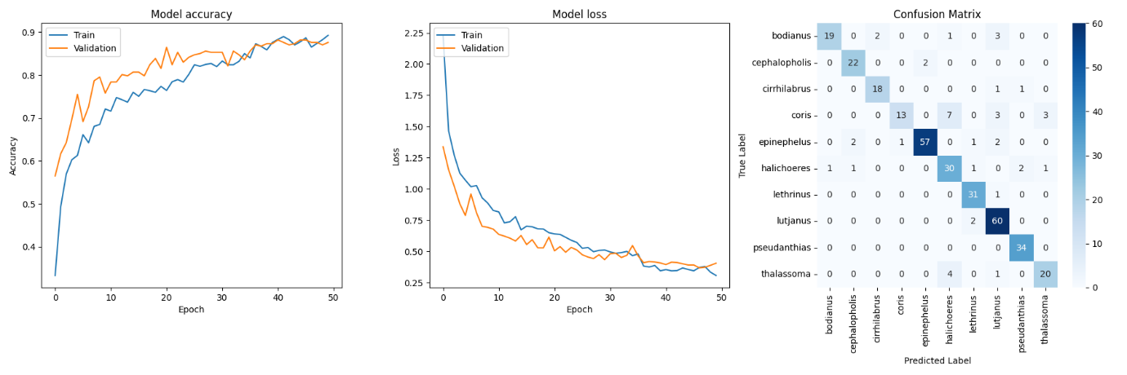
Xception
Architecture: Depthwise separable convolutions.
Accuracy: 87.61%
Plots: Confusion Matrix, Training & Validation Accuracy and Loss

Slide 11
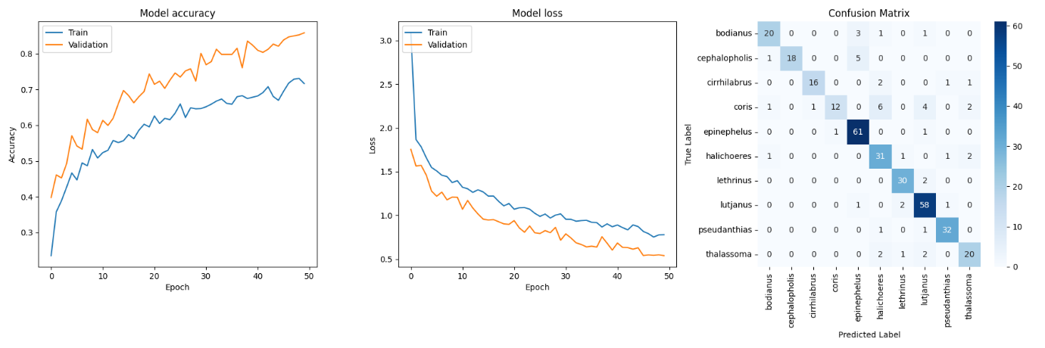
InceptionV3
Architecture: Inception modules with multiple convolutional kernels.
Accuracy: 83.72%
Plot: Confusion Matrix, Training & Validation Accuracy and Loss

Slide 12
EfficientNetB0
Architecture: Compound scaling method.
Accuracy: 75.50%
Plot: Confusion Matrix, Training & Validation Accuracy and Loss

Slide 13
ResNet50
Architecture: Residual connections.
Accuracy: 82.54%
Plot: Confusion Matrix, Training & Validation Accuracy and Loss

Slide 14

Traditional Machine Learning Models

Slide 15
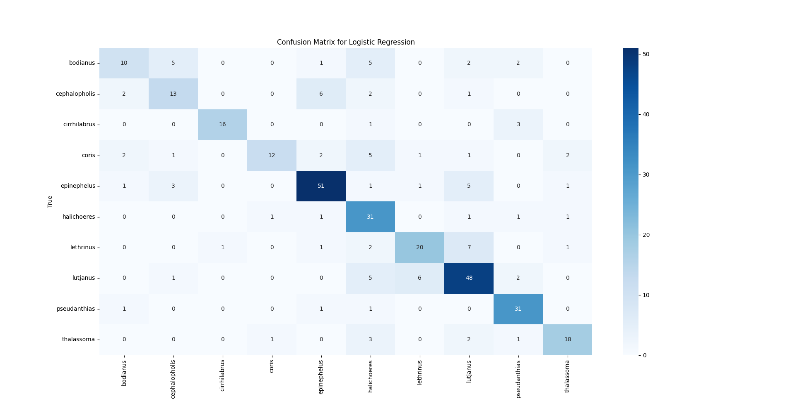
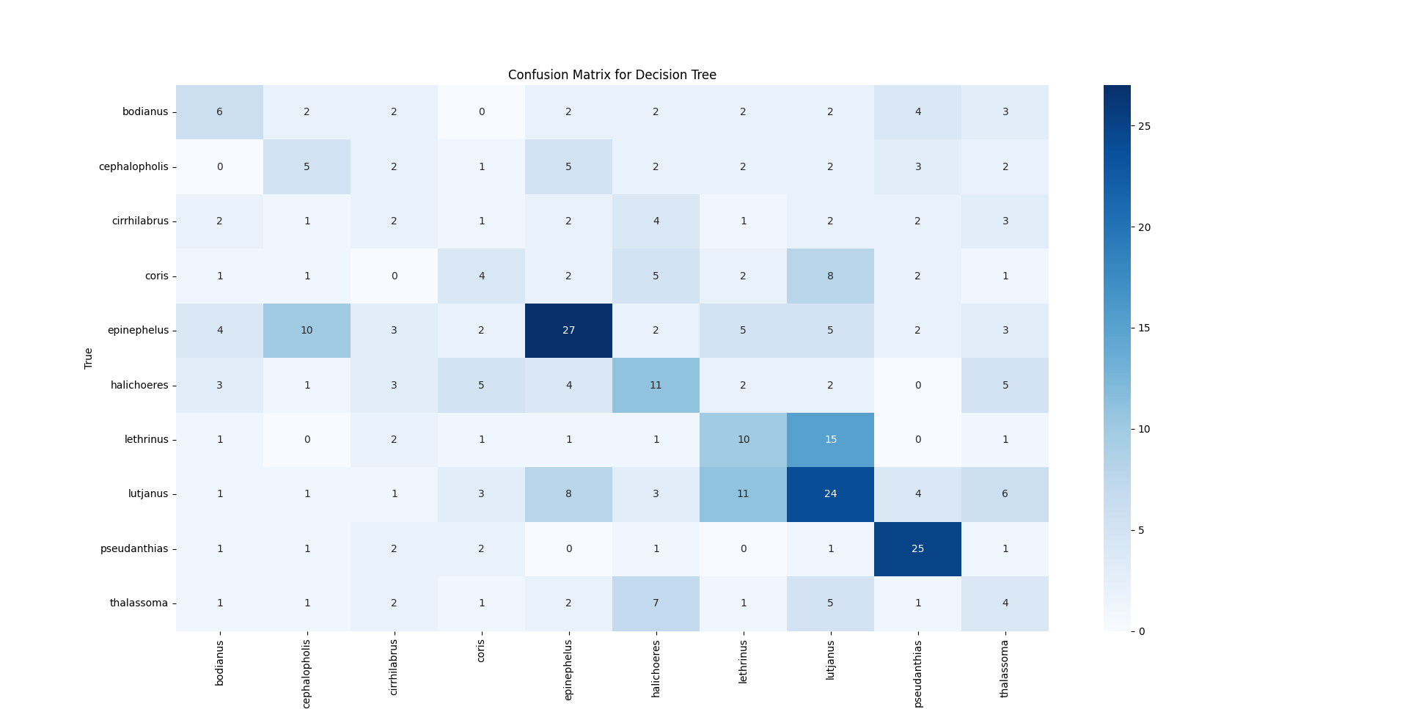
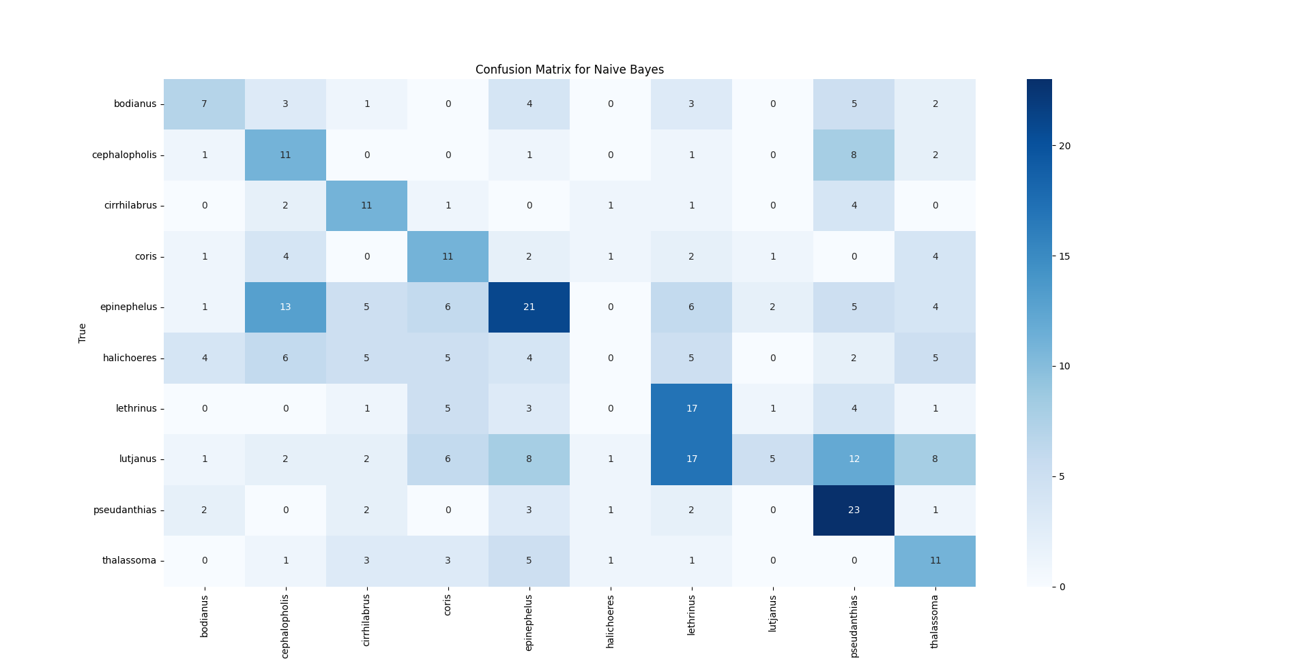
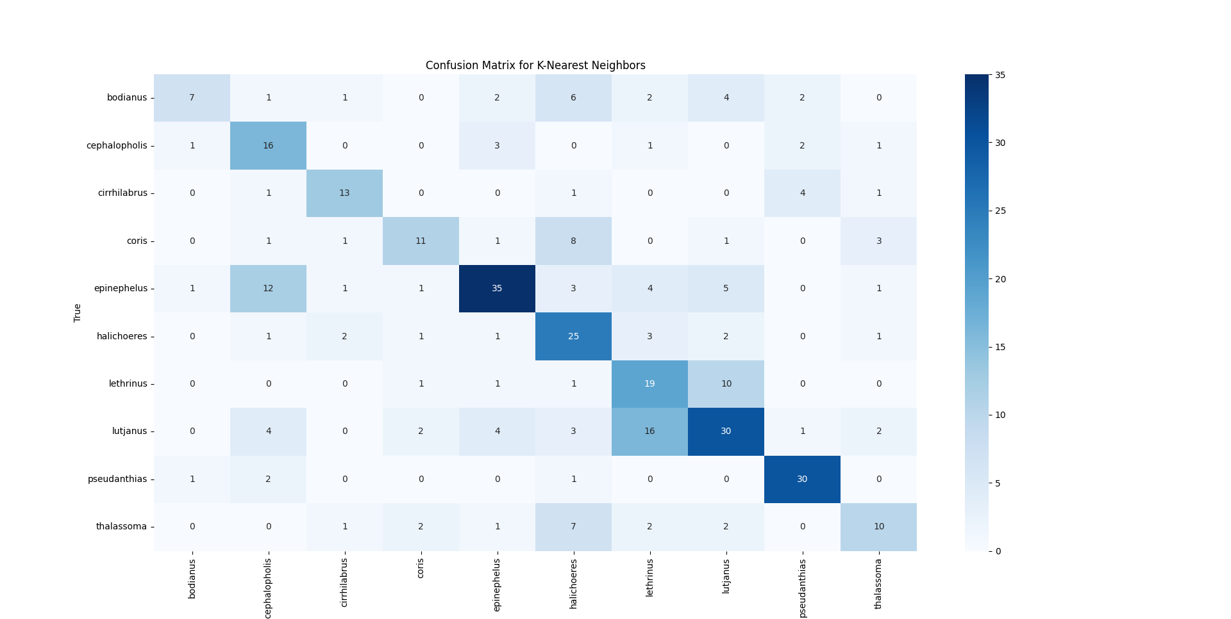
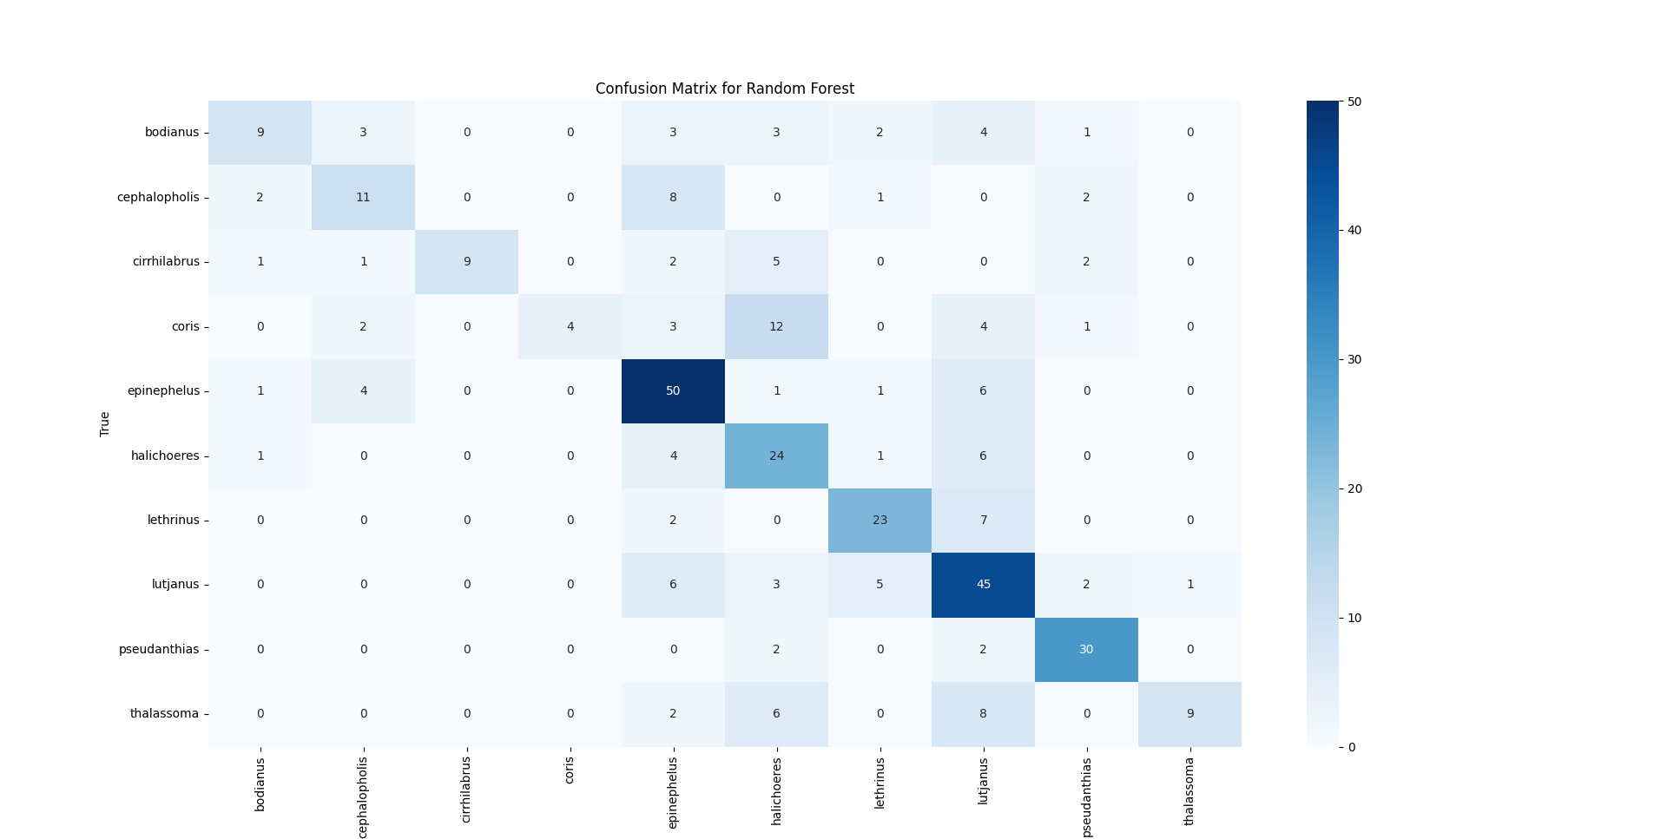
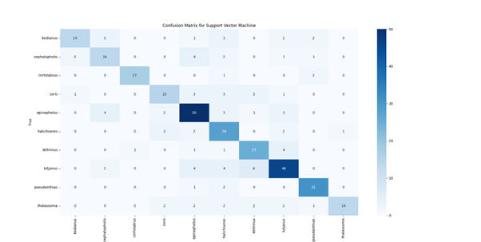
Accuracy SVM: 73.20%
KNN: 56.48%
Random Forest: 61.67%
Decision Tree: 34.01%
Naive Bayes: 33.72%
Logistic Regression: 72.05%

Slide 16

Comparative Analysis

Slide 17
Model | Accuracy | Key Characteristics | Comparison with Previous Studies
Custom CNN | 80.00% | Simple architecture with three convolutional layers and dropout. | Below typical accuracies (e.g., 98.88% by Kaya et al. with ANN) but simpler architecture.
MobileNetV2 | 83.57% | Lightweight with depth-wise separable convolutions; optimized for mobile devices. | Lower than CNN-based approaches like Taheri-Garavand et al. (98.21%) but efficient for mobile applications.
VGG16 | 87.61% | Deep architecture; transfer learning; computationally expensive. | Comparable to Rekha et al. (92%) and dos Santos and Gonçalves (96%) using CNNs.
DenseNet121 | 90.20% | Dense connectivity facilitating feature reuse and high accuracy. | Similar performance to models like Alsmadi et al. (90%) with MA-B Classifier and dos Santos and Gonçalves (96%).
Xception | 87.61% | Depth-wise separable convolutions; handles complex patterns well. | Slightly lower than advanced deep CNNs like Taheri-Garavand et al. (98.21%), but competitive with other CNNs.
InceptionV3 | 83.72% | Uses inception modules with multiple convolutional kernels. | Performance falls behind high-accuracy models like Kutlu et al. (99%) using Nearest Neighbour.
EfficientNetB0 | 75.50% | Compound scaling method; less effective on this dataset. | Below most recent CNN models, e.g., dos Santos and Gonçalves (96%), indicating limitations on this dataset.
ResNet50 | 82.54% | Residual connections aiding in deeper network training. | Performance is mid-range compared to top CNNs, e.g., Kratzert and Mader (93.3%).
SVM | 73.20% | Constructs hyperplanes for separation; less effective on high-dimensional image data. | Lower than many SVM-based methods, e.g., Fouad et al. (94.44%) and Hossain et al. (91.7%).
KNN | 56.48% | Instance-based; struggles with high-dimensionality of image data. | Underperforms significantly compared to Freitas et al. (92.3%) using SVM and KNN.
Random Forest | 61.67% | Ensemble of decision trees; less effective on image features. | Much lower than Saitoh et al. (87.3%) using RF, showing the limitations of RF on this dataset.
Decision Tree | 34.01% | Splits data into branches; tends to overfit on complex datasets. | Poor performance compared to most models, emphasizing its unsuitability for complex image data.
Naive Bayes | 33.72% | Probabilistic with independence assumption; suboptimal for image data. | Underperforms compared to Işçimen et al. (93.10%) using Naive Bayesian classifier.
Logistic Regression | 72.05% | Linear model adapted for multiclass classification. | Slightly lower than typical SVM-based methods like Islam et al. (90%).

Slide 18

Summary of Findings
Deep Learning Performance: DenseNet121 at 90.20%, VGG16 and Xception at 87.61%.
Transfer Learning Impact: Significant improvement in performance with pre-trained models.
Traditional vs. Deep Learning: Traditional models, such as SVM, lag behind deep learning models.
EDA Contributions: Provided valuable insights for model improvements.
Data Augmentation: Enhanced model robustness and generalization.

Slide 19

Contributions to the Field
High-Performing Models: Demonstrated potential of CNNs in automated fish classification.
Transfer Learning Integration: Effective use of pre-trained models for limited data tasks.
Comprehensive EDA Framework: Methodology applicable to other image classification domains.
Benchmarking Traditional Methods: Provided a clear comparison and highlighted deep learning advantages.

Slide 20

Conclusion
Deep Learning Models: Effective and scalable solution for fish species classification.
Performance Advantage: Outperforms traditional methods and offers significant improvements.
Future Exploration: Continued research and innovation in deep learning applications for ecological challenges.

Slide 21

Limitations of the Study
Dataset Size and Diversity: Limited scope affecting generalizability.
Model Complexity and Resources: High computational requirements.
Generalization: Need for testing models on diverse datasets.
Hyperparameter Tuning: Further improvements possible with more extensive tuning.

Slide 22

What’s next
LOOKING AHEAD

Slide 23
Future Work
Expand Dataset: Larger, diverse dataset for improved model generalization.
Explore Advanced Architectures: Novel models like transformers and attention-based networks.
Develop Real-Time Applications: Lightweight models for mobile and embedded systems.
Integrate Multimodal Data: Use additional data for context-aware identification.
Create User-Friendly Tools: Interfaces for field use by researchers and managers.
Conduct Longitudinal Studies: Assess model robustness over time.

Slide 24

Questions

Slide 25
THANK YOU

